Slide 1


IMAGE SCRAPING AND CLASSIFICATION
Submitted by:
Arpan Pattanayak

Slide 2
CONCEPTUAL BACKGROUND OF THE DOMAIN PROBLEM
Images are one of the major sources of data in the field of data science and AI.
This field is making appropriate use of information that can be gathered through images by examining its features and details.
The idea behind this project is to build a deep learning-based Image Classification model on images that will be scraped from e-commerce portal. This is done to make the model more and more robust.

Slide 3
PROBLEM STATEMENT
We have to scrape images from e-commerce portal, Amazon.IN The clothing categories used for scraping will be:
Sarees (women)
Trousers (men)
Jeans (men)
After the data collection and preparation is done, you need to build an image classification model that will classify between these 3 categories mentioned above.

Slide 4
ANALYTICAL PROBLEM FRAMING
Data Collection Phase:
We have collected/scraped data from amazon for the three categories: Sarees, Jeans and Trousers.
In total there are 343 rows for each of the items

Slide 5
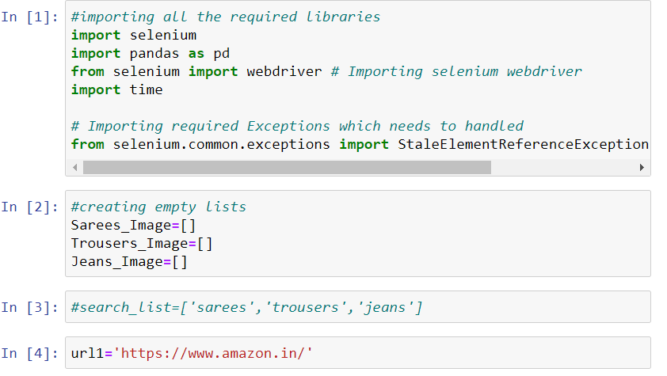
ANALYTICAL PROBLEM FRAMING

Slide 6
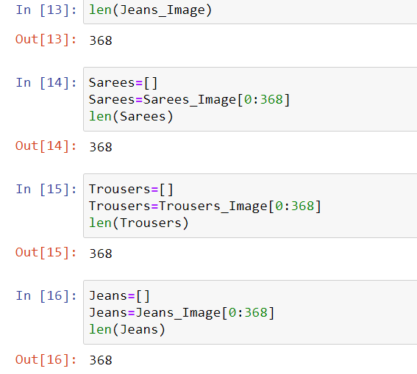
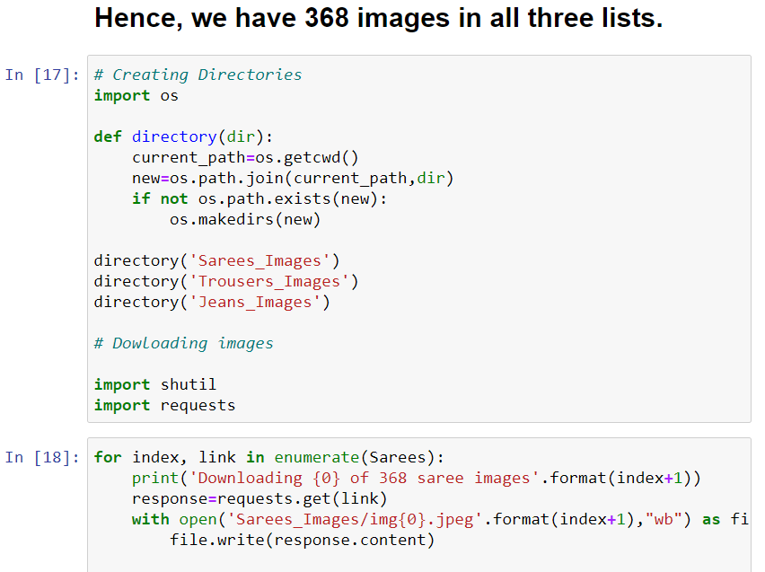

Slide 7
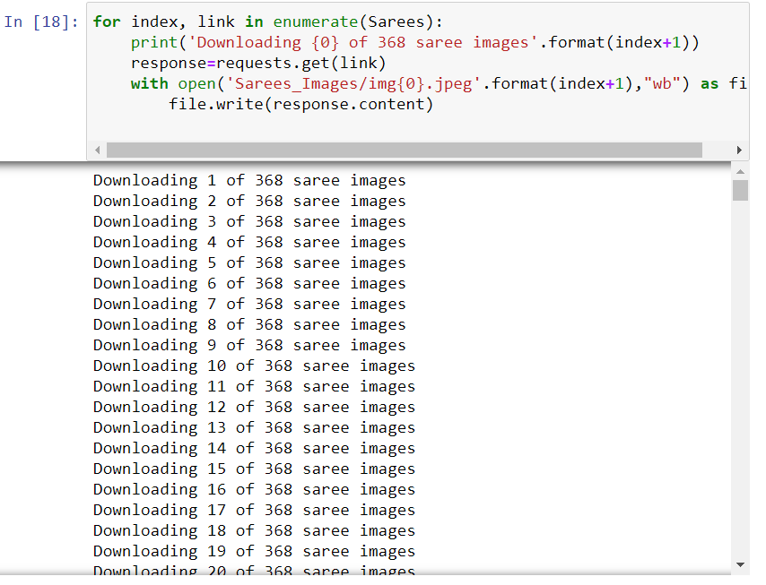
Next we created directories to store images of each clothing item scraped above. Further we will be downloading images to required folders/directories along with download status message.

Slide 8
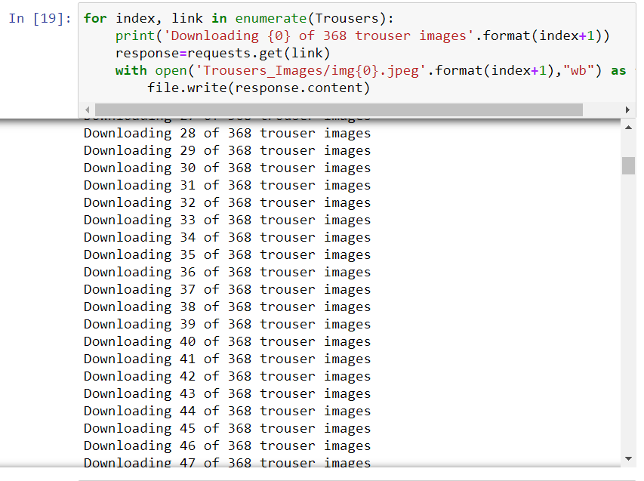
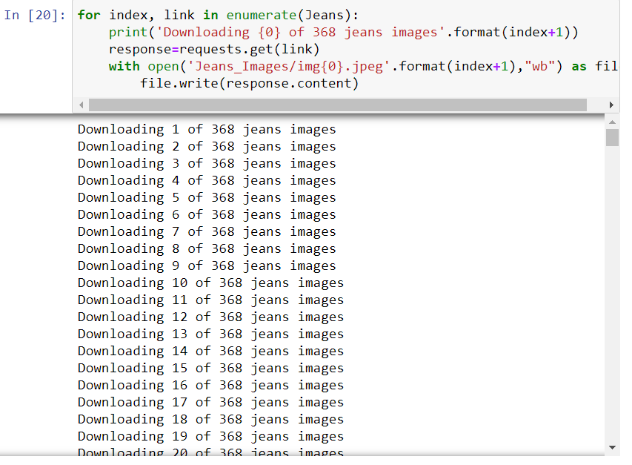

Slide 9
MODEL/S DEVELOPMENT AND EVALUATION
After collecting the data we next do training of the data. For that firstly, we created a main folder called “Clothes” in current working directory inside which I further created two folders called “Train” and “Test”.
In Train folder we have kept 250 images from each clothing category and remaining 118 images we have kept in Test folder for each category. Hence, we got 750 images for training and 354 for testing.

Slide 10
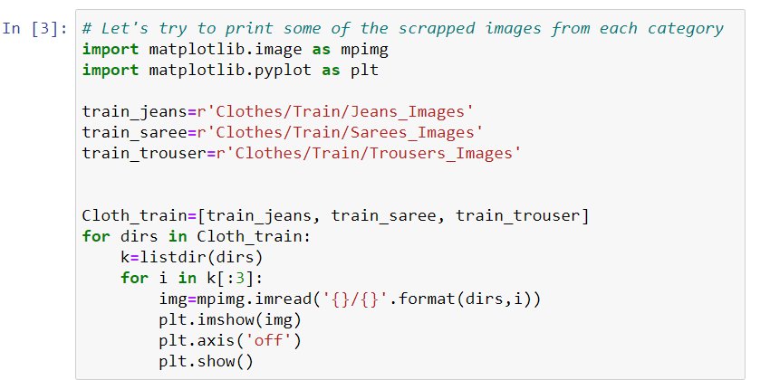

Slide 11
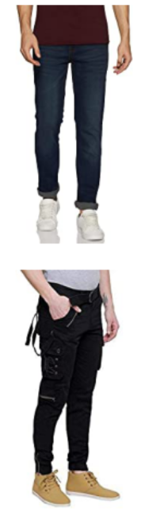
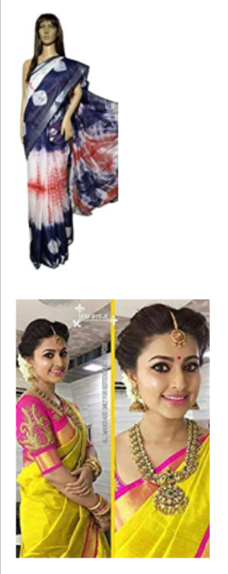
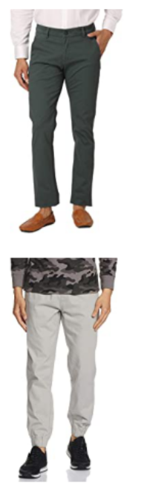
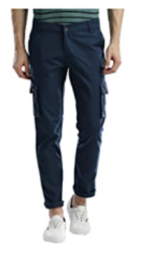

Slide 12
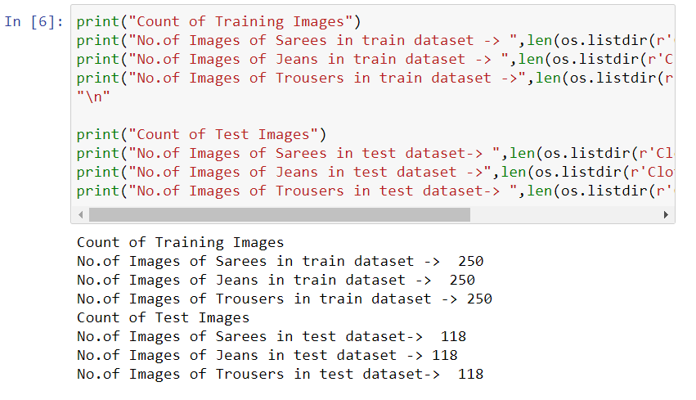
Next we defined dimensions of images and other parameters also. Then, for data augmentation we defined training and testing set.

Slide 13
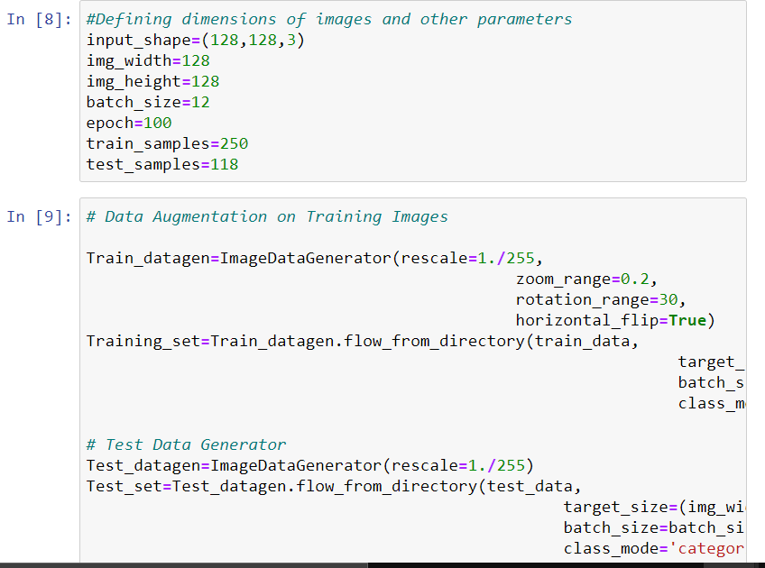
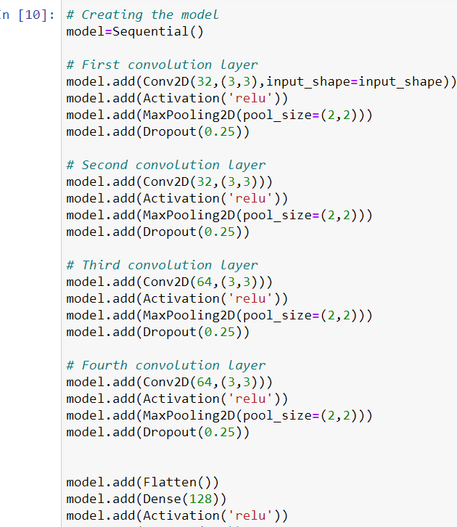
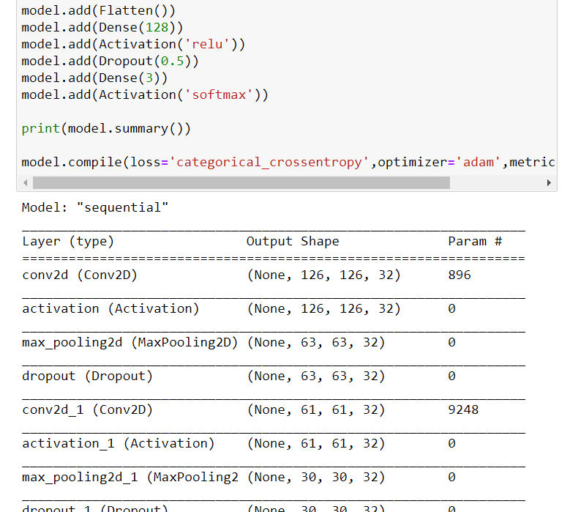

Slide 14
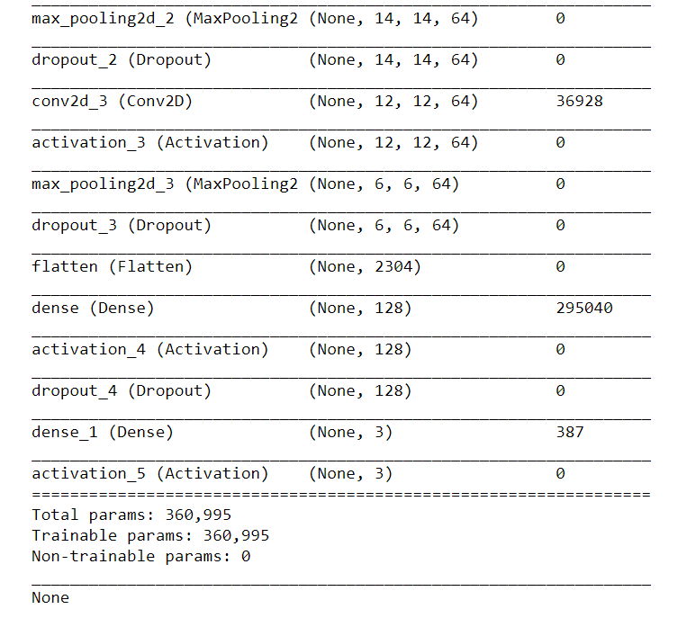
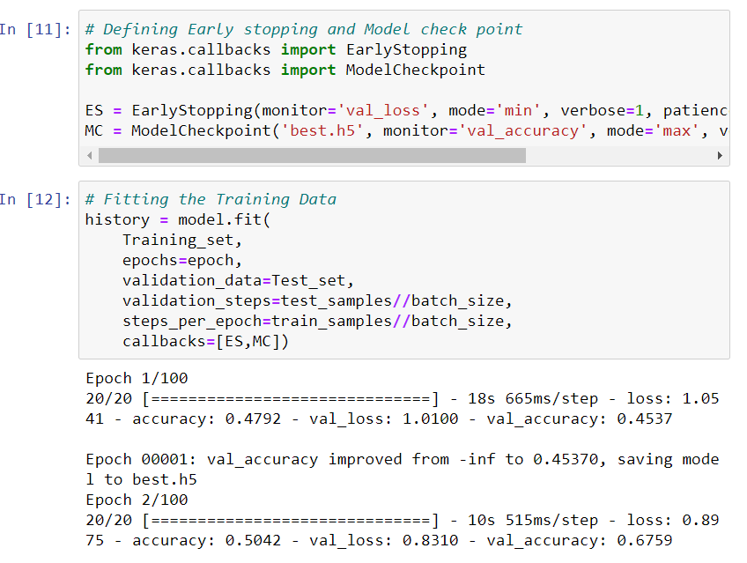
Then we defined Early Stop criteria and saved the model as ‘best.h5’ for the best results.

Slide 15
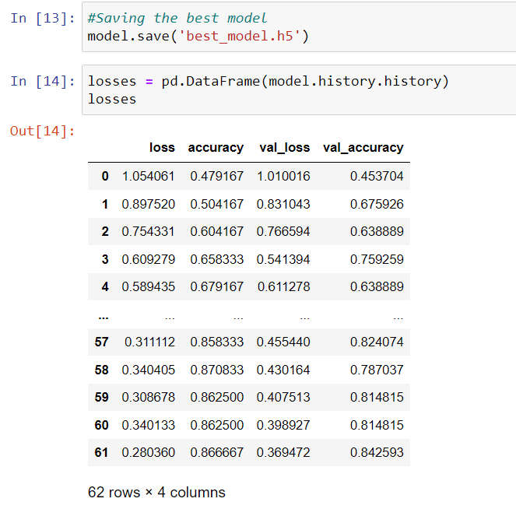

Slide 16
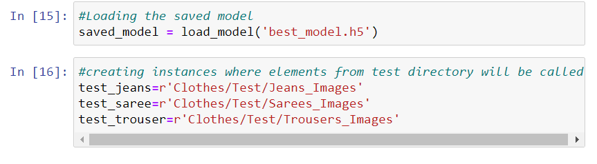
PREDICTION
Now, we load our saved model and do prediction of our test images.
For that we first load all the test images from test folder created in main folder Clothes
Then we predicted the images and displayed it.

Slide 17
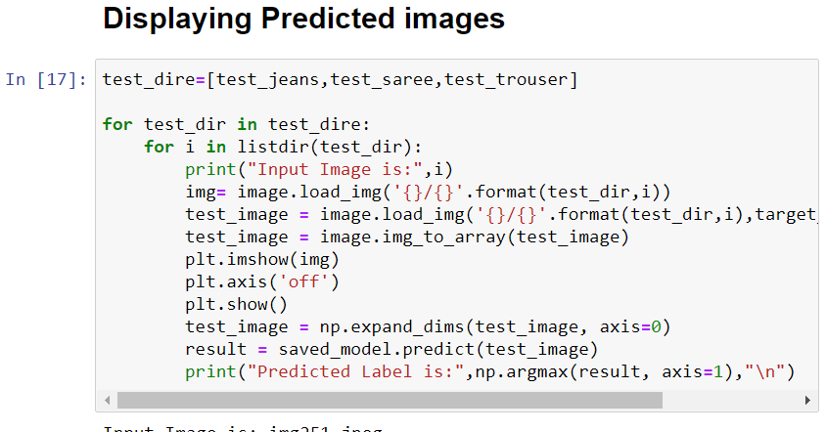
Predicted Images

Slide 18
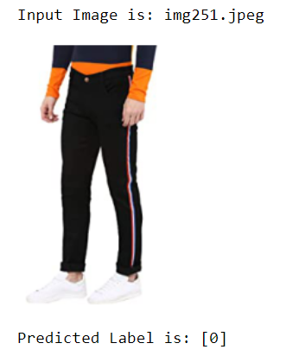
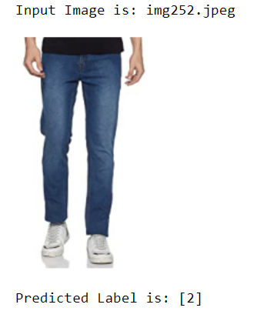

Slide 19
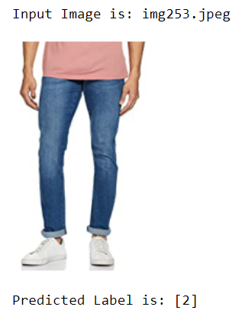
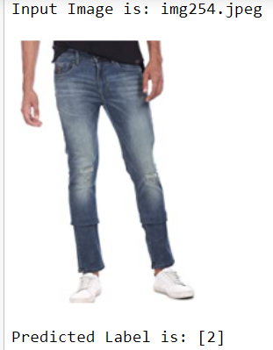

Slide 20
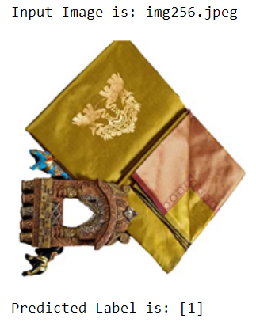
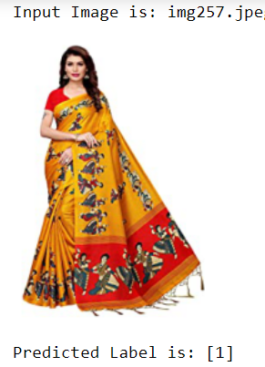

Slide 21
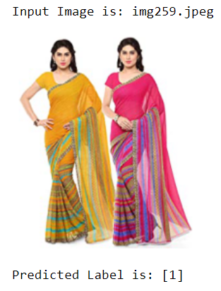
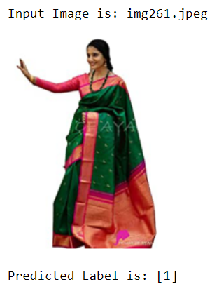

Slide 22
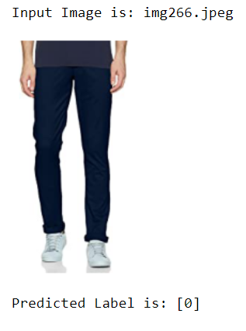
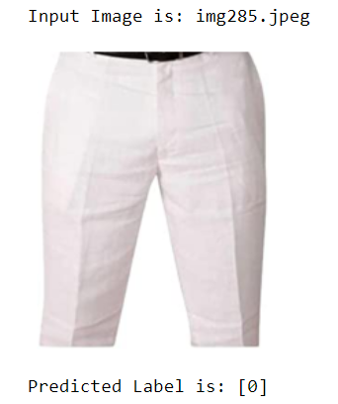

Slide 23
CONCLUSION
Our model is working well and gave accuracy of 88%.
It was able to classify the three clothing items distinctly.
Since in all three categories there were some extra/unnecessary items other than the main items hence, it could have been removed and we could have got better result. Moreover, training data could have been increased.

